Slide 1
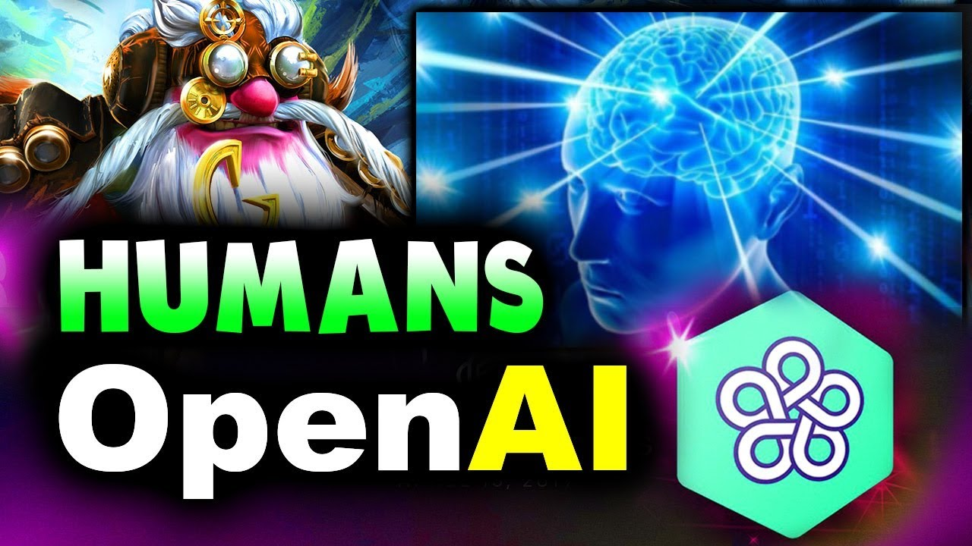
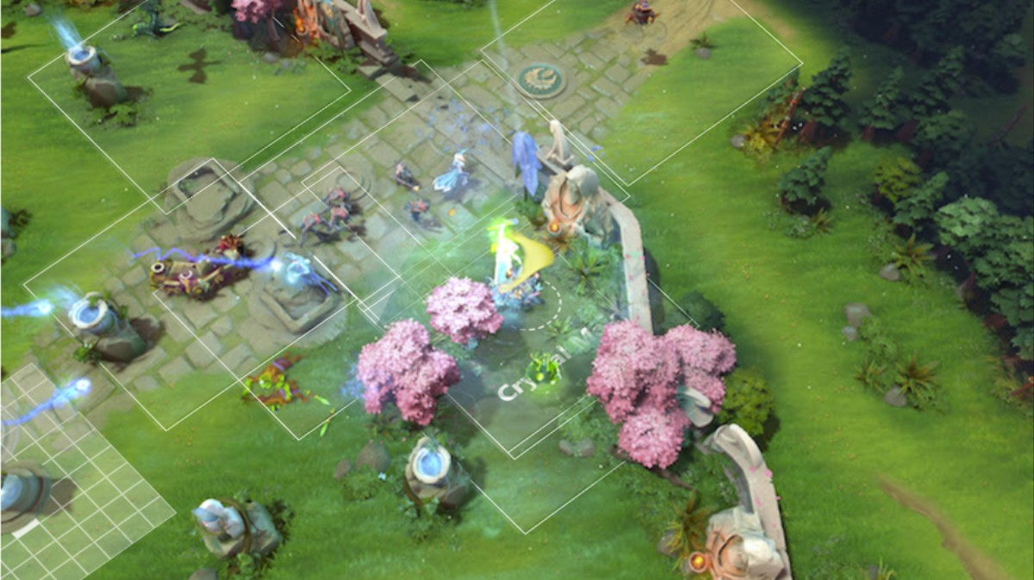
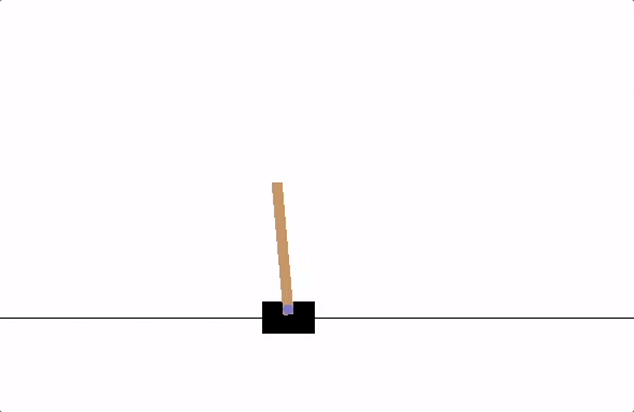
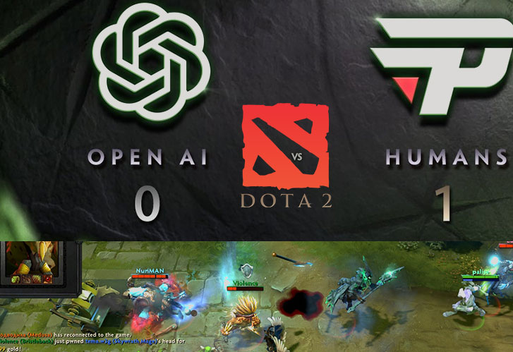
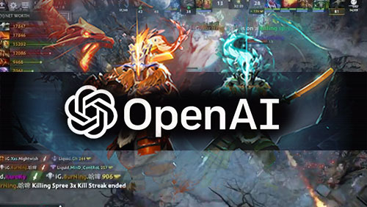
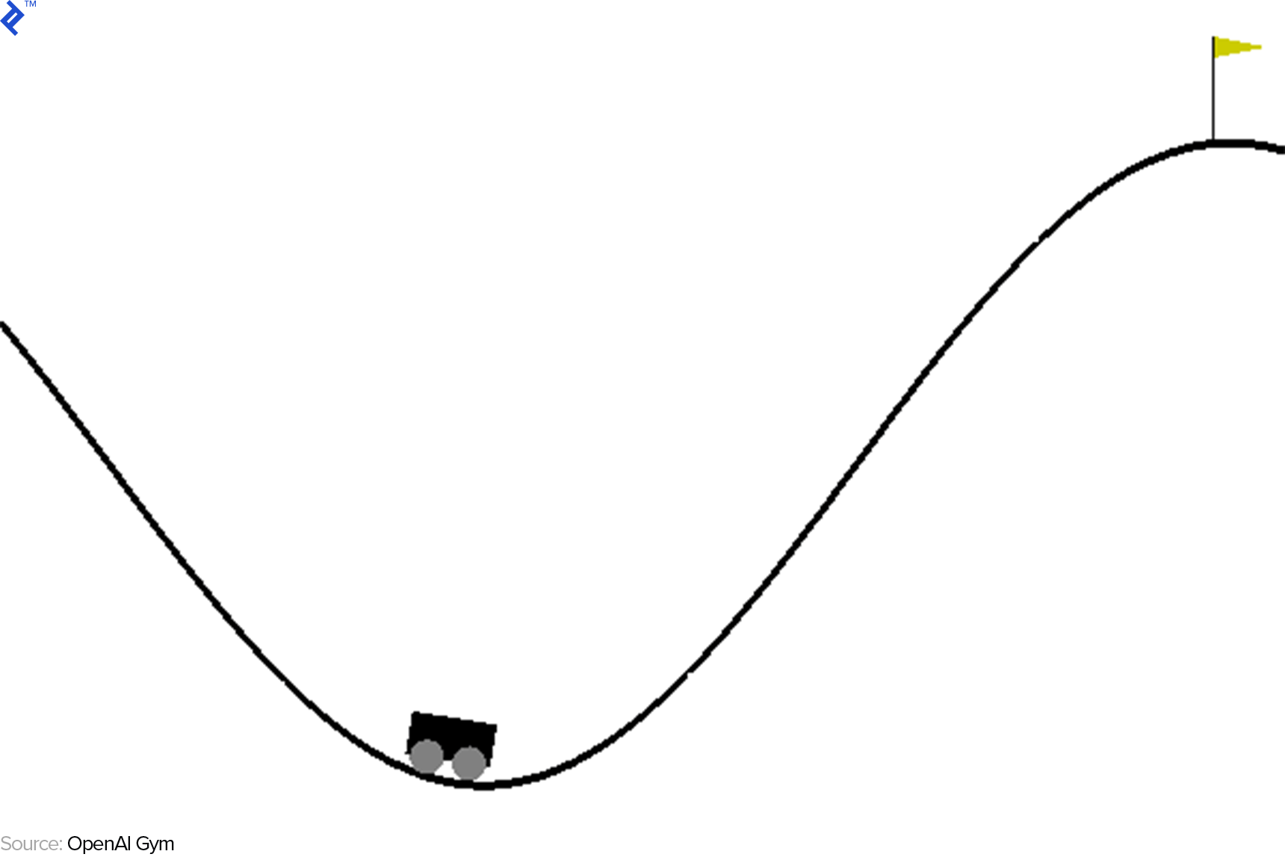
Generalizing Transfer Learning in Reinforcement Learning with
Newer Regularizations in Coinrun
Eamon | Hakon | Theo

Slide 2




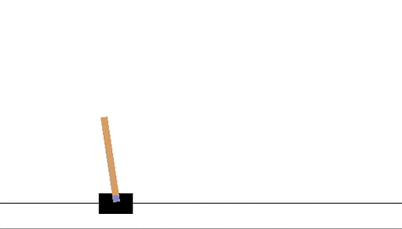
Quick Description on Reinforcement Learning
Reinforcement Learning
Allowing an agent to learn from an interactive environment through trial and error.
Environment
State
Reward
Policy
Value
The world in which the agent is deployed,
e.g. a game
Current situation, i.e. the aggregation of rewards and penalties
Reaction or feedback from the environment, e.g. points you get for taking an action
Rule or methods to map state to actions of agents, e.g. act to maximize reward
Future Reward for taking a certain action in a certain state (contextual)
Source: Shweta Bhatt (2018), Flaticon

Slide 3
Quick Description on Q-learning
Q-Learning
A value-based reinforcement learning algorithm used to find the optimal selection policy using a Q-function
5 essential steps in Q-learning
1
Q-table: a lookup table used to calculate max expected future rewards for action at each state
Initialize Q-table
Choose Action
2
Ultimately, it is about maximizing value function Q
Perform Action
Many iterations
Measure Reward
Update Q-table
Source: ADL (2018)

Slide 4
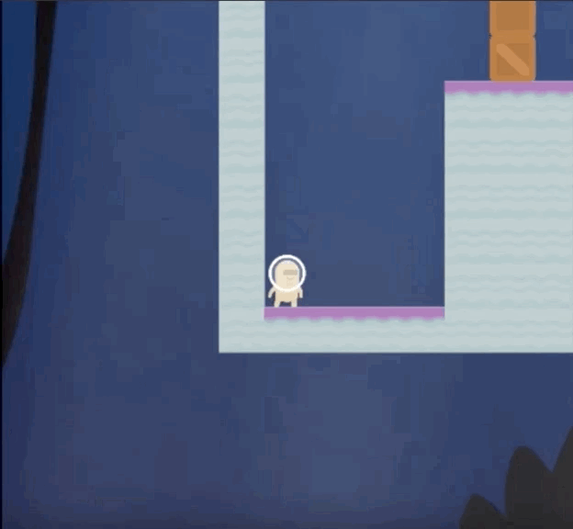
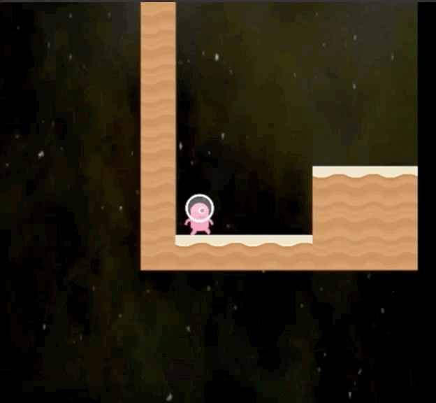
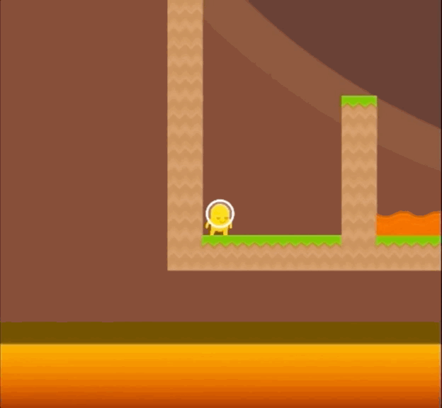
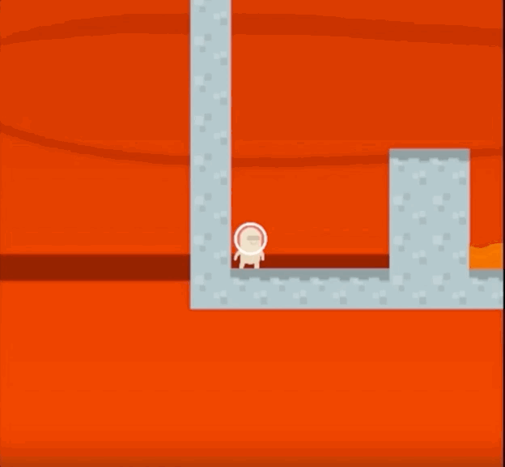
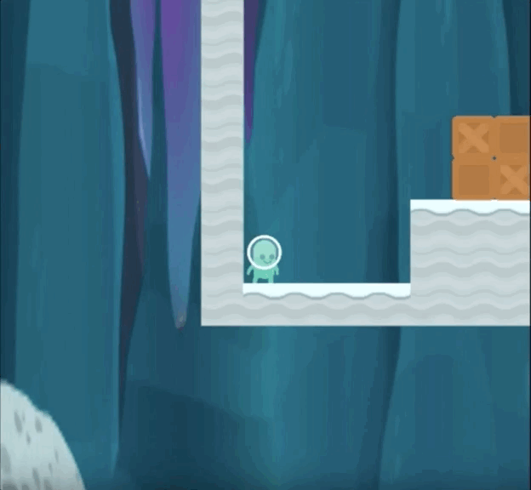
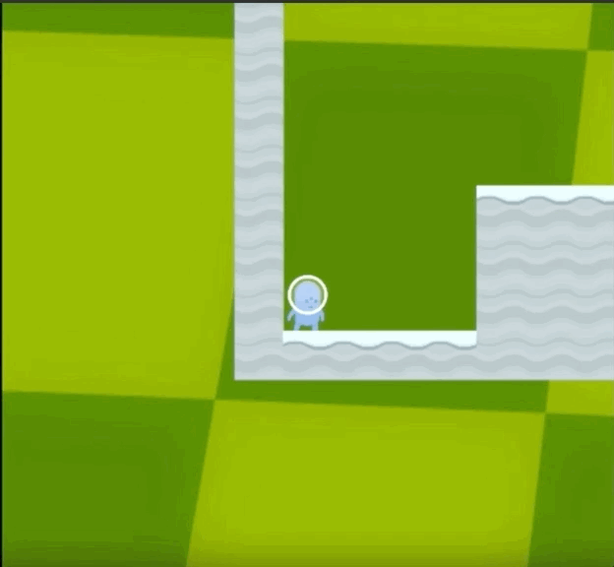
Incomes the Coinrun Environment, like a simplified Sonic Game
Source: OpenAI Twtter (2018)

Slide 5
Training: Incomes the Coinrun Environment, like a simplified Sonic Game
An environment generator that provides a metric for an agent’s ability to generalize across new environments
Levels are procedurally generated
Goal is to collect a single coin at the end of each level
Key: Train on some random amount of levels, and test on previously unseen levels. This usually results in overfitting and currently, the more levels trained with, the better the performance in the test.
Source: OpenAI Twtter (2018)

Slide 6
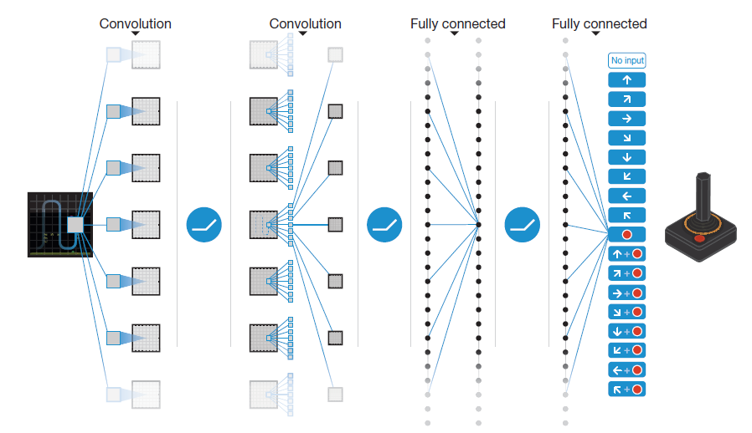
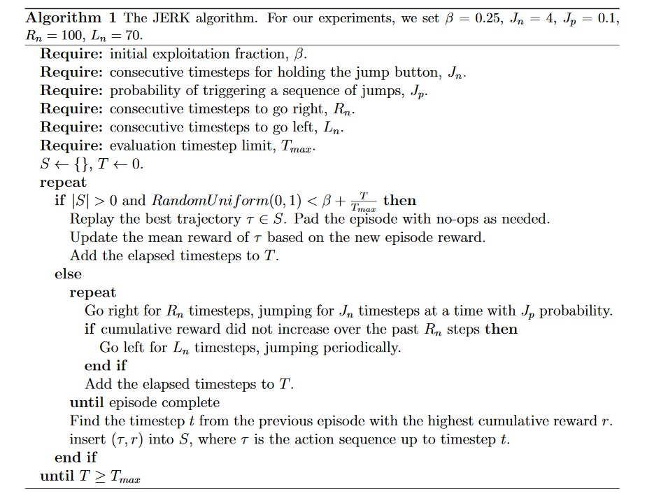
Our Model and Baselines: Nature-CNN and JERK
Comparing our performance in Nature-CNN with JERK
1
Nature-CNN
2
JERK (Just enough Retained Knowledge)
Standard DQN setup that included the use of
a neural network (in contrast to JERK)
Reward-driven, ignores observations; rewards past actions that historically agent better than others
Source: OpenAI (2018)

Slide 7
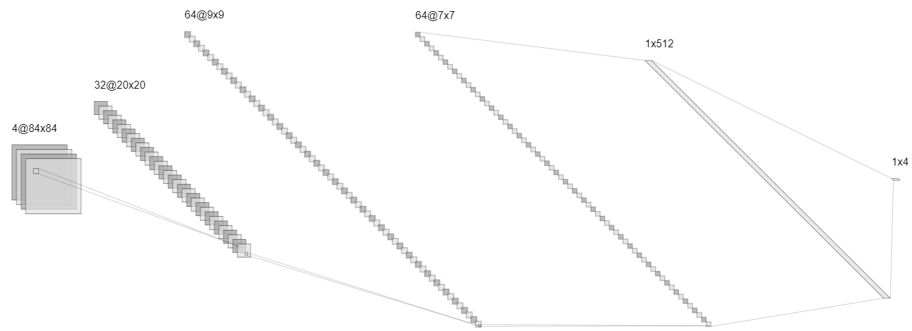
Model Hyperparameters and setup
Model setup
Hyperparameters description | Value
Learning Rate | 2.5e-4
Total Time Step(s) | 5e4
Buffer Size (replay memory) | 5e4
Exploration Fraction | 0.1
Exploration Final EPS | 0.02

Slide 8
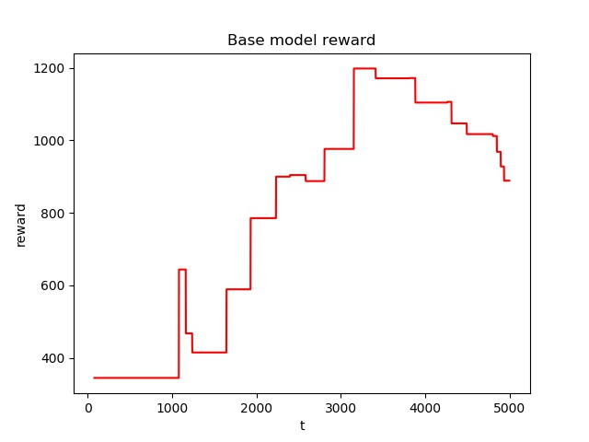
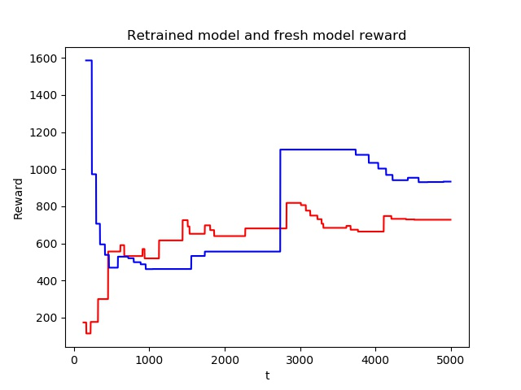
Our Results: First Step
Base model rewards *(without transfer learning)
Retrained model rewards*
Retrained model
Base model
Still need better
Hyperparameter
finetuning
Key Takeaway: Even some hyperparameter searches combined with basic transfer learning should yield better performance than letting the agent go wild on its own.
*Reward here means the average number of levels cleared

Slide 9
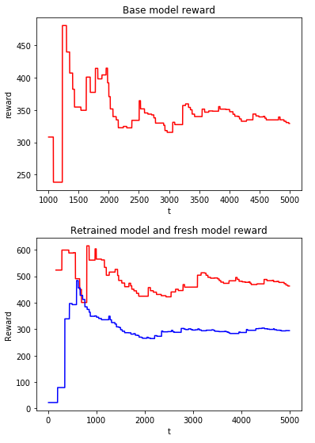
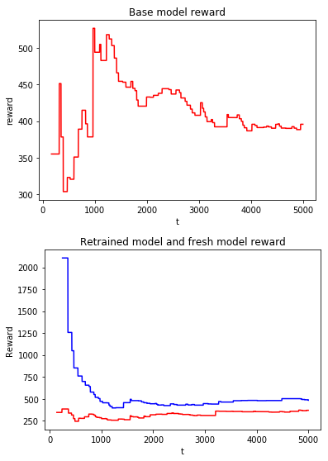
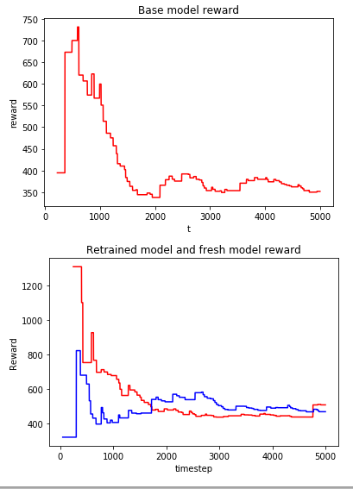
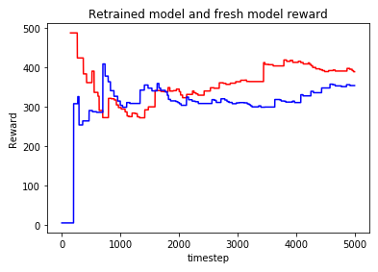
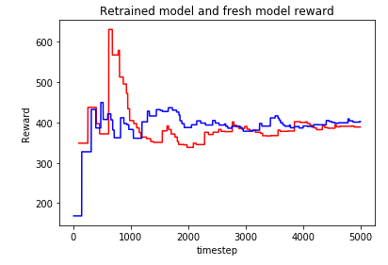
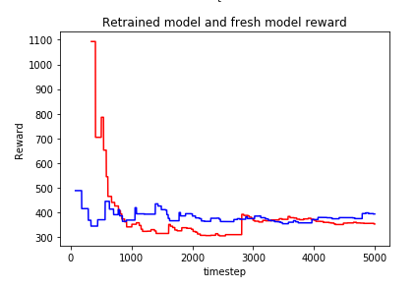
Our Improvements: Regularizations by adding Gaussian Noise Layers
One noise layer
Two noise layers
Three noise layers
Retrained model
Retrained model
Retrained model
Base model
Base model
Base model
Noise sd: 1
Retrained model
Retrained model
Base model
Base model
Noise sd: 0.5
Retrained model
Base model

Slide 10
Our Improvements: Regularizations by adding Gaussian noise layers
Conclusion: Adding more layers does or further regularizing it
DOES NOT necessarily make a better model to transfer to other
levels. The best performer is 1 layer of noise at standard deviation=1.
One noise layer
Two noise layers
Three noise layers
Noise sd: 1
Noise sd: 0.5

Slide 11
Conclusion: What’s next?
Possible Future Implementations to Improve the Model
1
Adding More Noise
2
Reducing Unnecessary Noise
Making sure it does not overfit by “confusing” the model more during training
Take out uncorrelated components that would not add value to the model
Future implementation:
General Adversarial Noise Layers
Future Implementation:
Spectral Dropout

Slide 12
Generalizing Transfer Learning in Reinforcement Learning with
Newer Regularizations in Coinrun
Eamon | Hakon | Theo

Slide 13
Q-function
Learning Rate
Discount rate
$$New Q\left(s, a\right)= Q\left(s, a\right)+α\left[R\left(S, a\right)+γ maxQ^{′}\left(s^{′}, a^{′}\right)−Q\left(s, a\right)\right], where$$
New Q Value for
state and action
Current Q values
Reward for taking action at that state
Max expected future reward given new state (s’) and all possible actions at that new state
Current Q values
Source: ADL (2018)

